Slide 1



Texas Instruments Foundational Technology Research Program on Millimeter Wave and High Frequency Microsystems
42 Month Review
August 6th, 2021

Slide 2
Texas Instruments Foundational Technology Research Program on Millimeter Wave and High Frequency Microsystems
42 Month Review
08:20-08:30 AM Check-in
08:30-09:00 AM Center Progress/Overview
09:00-09:50 AM 0.41-THz CMOS-based Short-Range Imager for Industrial Applications
09:50-10:30 AM Code-Modulated Embedded Test of Multifunctional Arrays
10:30-10:40 AM Break
10:40-11:20 AM Packaging and Material Spectroscopy to Support Terahertz Microsystems
11:20-12:00 PM Infrared Detection Using Structures in Foundry CMOS
12:00-12:10 PM Set up for lunch
12:10-12:50 PM 170GHz – 260GHz Wideband PA and LNA Design in Silicon
12:50-01:30 PM Advanced Algorithms for Terahertz Sensing and Recognition
01:30-02:00 PM Discussion

Slide 3
Advanced Algorithms for Terahertz Sensing and Recognition
Murat Torlak and Yiorgos Makris
University of Texas at Dallas
Texas Instruments Foundational Technology Research Program on Millimeter Wave and High Frequency Microsystems
University of Texas at Dallas
August 6th, 2021

Slide 4
Advanced Algorithms for THz Sensing and Recognition
Description: Understand the limitations and challenges in THz FPA/IR imaging technology; identify solutions for target applications such as 3D gesture recognition, movement and presence detection.
Goals: Develop advanced real-time multi-antenna signal processing techniques for THz FPA/IR sensors to reconstruct and recognize targets in complex environments.
Principal Investigator: Murat Torlak (University of Texas at Dallas)
Yiorgos Makris (University of Texas at Dallas)
Students Current Status
Josiah W. Smith (MT) Ph.D.
Shiva S. Thiagarajan (YM) Ph.D.
Christos Vasileiou (YM) Ph.D.
Liaison: Anand Dabak

Slide 5
Plans and Deliverables (Year 4)
Milestones
Fabricate various junctions (Tape out next week).
Measure and model the junctions including noise performance (May 31st, 2018).
Design 20-THz detectors using various junctions (July 31st, 2018).
Deliverables
Models of junctions (May 31st, 2018).
Report on the design of 20-THz detector (August 31st, 2018).
.

Slide 6
Major Accomplishments – BULLET POINT
Investigated data-driven approach for high resolution envelope imaging. Developed THz imaging simulator and integrating imaging pipeline for new THz chip.
Developed CNN models to improve image resolution and denoising using super-resolution techniques, along with automated parameter space exploration for best results.

Slide 7
Plans and Deliverables (Year 3/4)
Milestones
Developed a MATLAB based GUI to streamline raw mmWave radar and THz radar data collection
Developed an advanced THz/mmWave image simulator to compare images
Performed the testing of machine learning methods with real mmWave data sets
Developed various application such as gesture recognition/imaging with 77GHz TI radar until THz radar becomes available
Worked on advanced machine learning algorithms, setup python-framework for improving dynamic gesture recognition models established in prior experiments using improved feature extraction methods.
Identified native system (PC) hardware platform for real-time implementation of dynamic gesture recognition models and developed USRP interface with THz radar
Deliverables
Algorithms and Software for Front-end DSP and ML methods
mmWave testbeds and THz chip USRP interface

Slide 8
TI Feedback and Accomplishments
Good synergy of Test-Circuits-Systems coming together.
COMET integration requirements into 410GHz imager – Can the processing be embedded in Si for final design (vs. externally through Matlab)?
Looking forward to impact of systems work on 410GHz imager – Foresee a lot of challenges before results come through.
Reestablished regular engagement with TI engineers.
Accomplishments:
Front-end signal processing and ML pipeline are ready for testing THz images
Modeled THz sensor imaging via simulator
Implemented feature extraction methods using various ML tools to improve classification model accuracy.

Slide 9
Revised Schedule
Year | 1 | 2 | 3 | 4 | 5
Milestones | Develop a detailed mathematical model for THz FPA with reflectors and THz transceivers. Develop a geometric reference model including Doppler shift patterns for 3D gesture recognition and motion detection Software implementation of machine learning algorithms for THz sensing/imaging. | Complete 24/77 GHz hardware demonstrator with existing chipsets to achieve millimeter-scale accuracy in 3D gesture recognition and motion recognition. Develop multi antenna signal processing to reduce speckles and to correct reflector aberration and machine learning techniques. | Software implementation of real-time multi antenna signal processing techniques and machine learning algorithms for THz-FPA on a custom CPU+GPU. Refine the mathematical models of THz-FPA and geometric models based on 77 GHz demonstrator results. | Verify and fine tune low complexity algorithms with THz FPA on silicon with TI and center collaborators. Software implementation of machine learning algorithms on a custom CPU+GPU for THz sensors. Finalize the algorithms to eliminate errors due to multipath. | (If all the milestones are met and authorized by TI) Build and characterize optimized resolution limits of THz FPA with THz chipsets incorporating reflectors and machine learning on CPU/GPU/FPGA for 3D gesture and motion recognition. Characterize the performance limits of aberration mitigation algorithms.
Deliverables | Report on the mathematical model of THz FPA with reflectors and THz radios Report on geometric models for 3D gesture recognition and the machine learning algorithms for THz sensing/imaging | Report on measurement results using 24/77 GHz demonstrator. Software implementation of multi antenna signal processing and machine learning for THz-FPA gesture and motion detection | Report on software implementation and refined mathematical models of the end-to-end sensing and imaging system with machine learning algorithms. Report on the algorithms to increase field of view. | Report on measurement results on the performance limits of multiantenna signal processing algorithms and machine learning techniques used in THz-FPA sensors. | Report on measurement results of fully functional THz-FPA imager enabled by real-time multiantenna signal processing algorithms and machine learning. CPU/GPU/FPGA software.

Slide 10
Front-End Signal Processing and Applications
Murat Torlak
Josiah W. Smith

Slide 11
Outline
Demo: Mail inspection scanner
System Design
Early Results + Analysis
SAR Imaging Pipeline to interface Machine Learning
2D SAR Imaging
Proposed Solution
Results
3D SAR Imaging
Results
Empirical Results
Dataset Generation
Synthetic Data
Real SAR Images
THz Imager

Slide 12

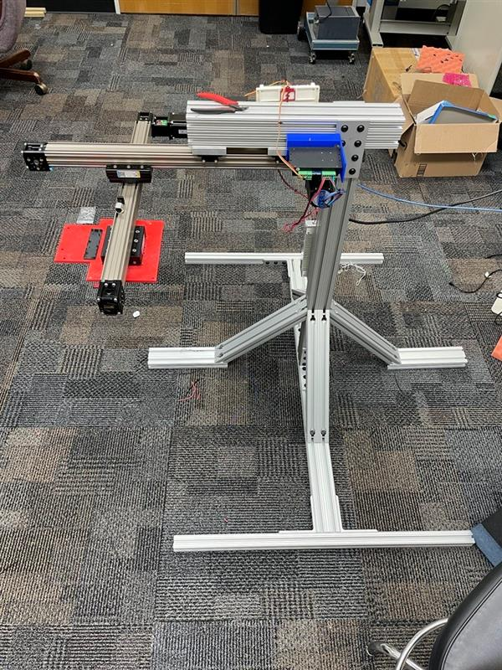
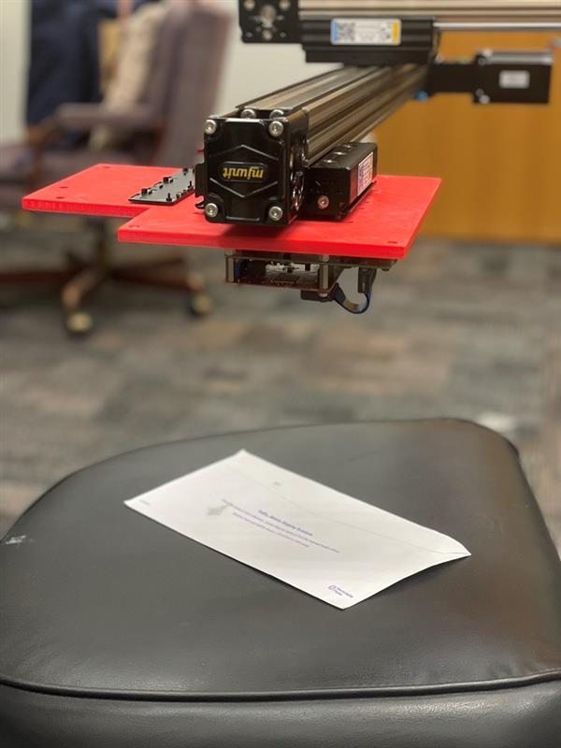
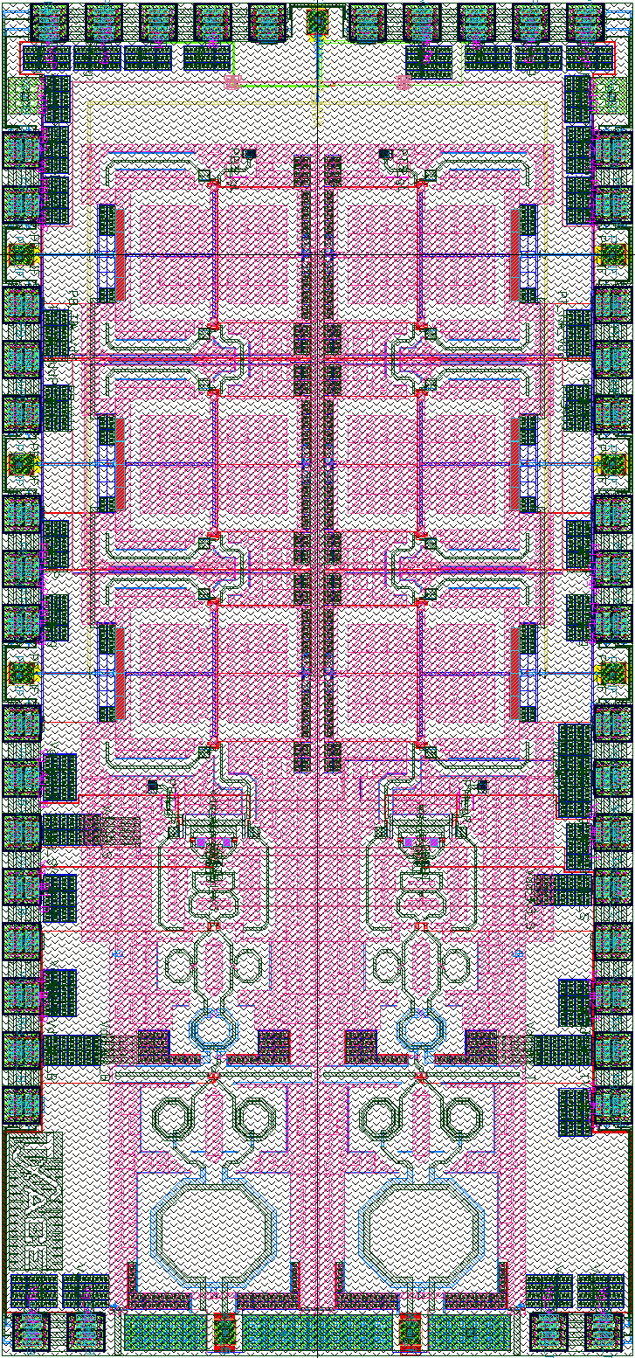

Mail Inspection Scanner
Mail inspection scanner
Requires downward-facing imaging system
Current system is vertically oriented
Built new, versatile system
1m
TI 77GHz mmWave Radar
Resolution scales with carrier frequency

Slide 13
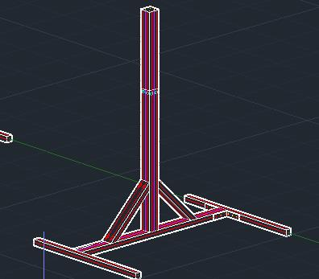
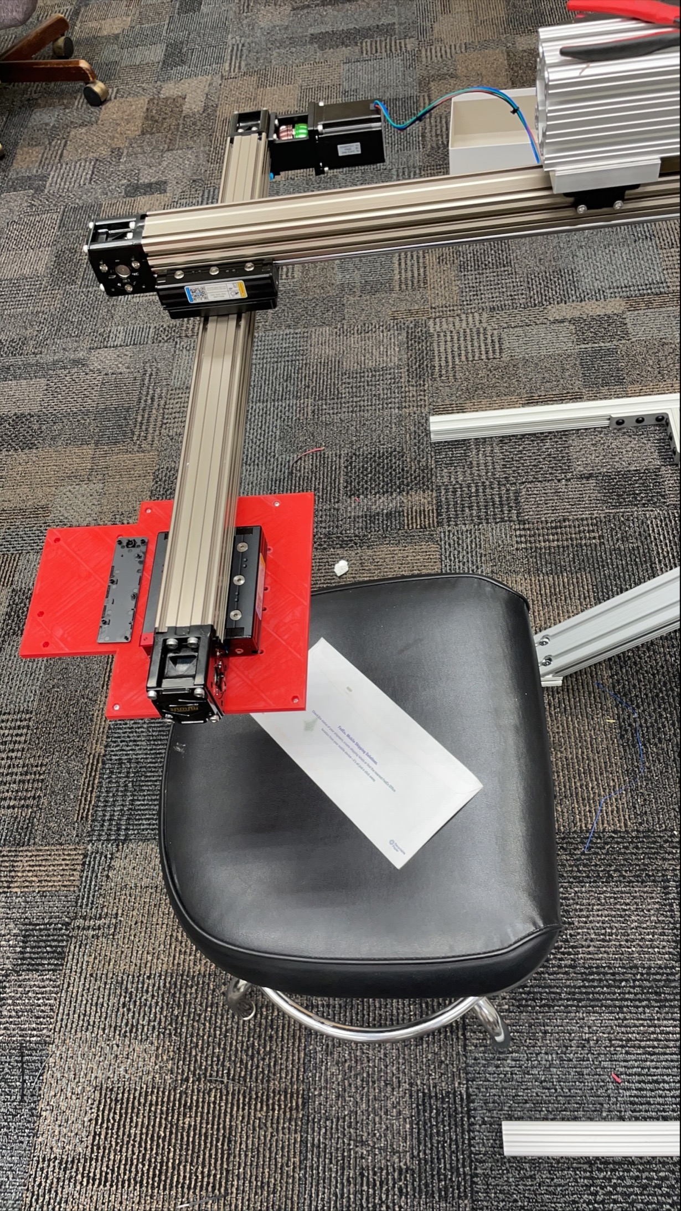
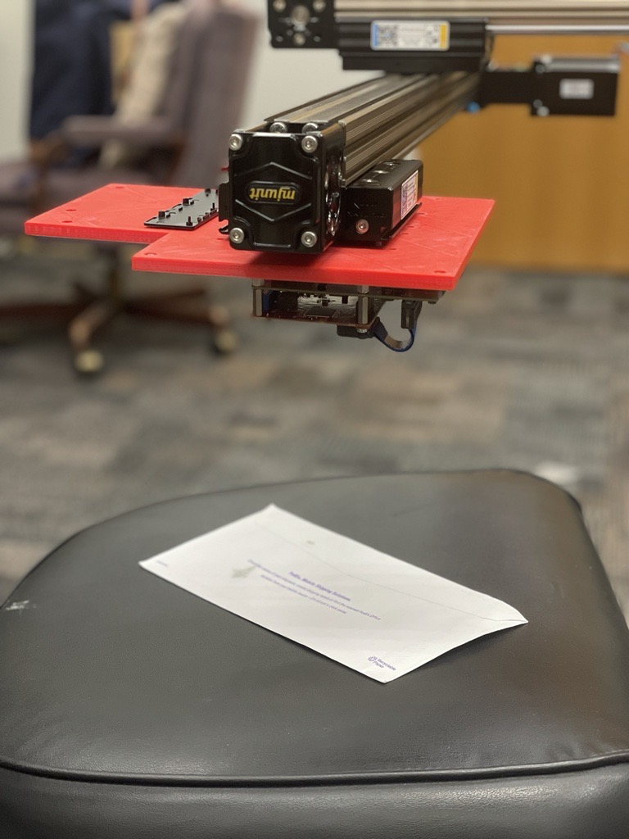
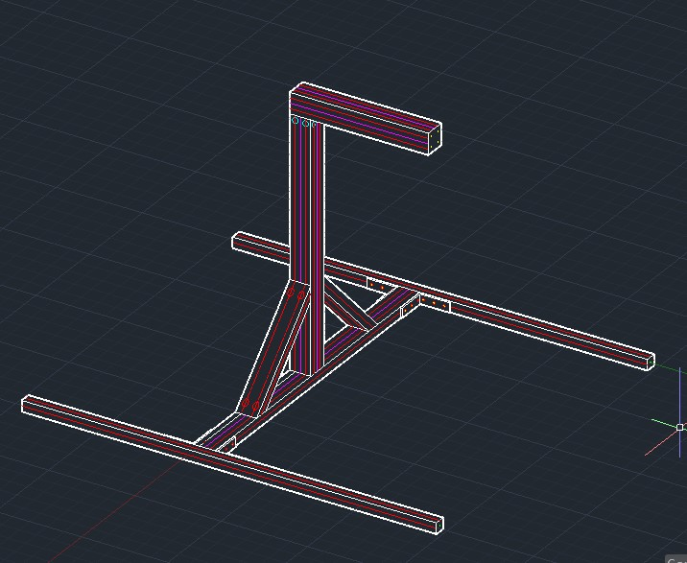
System Design
Dual mode scanner
Vertical or horizontal orientation
Simulates mail inspection scanner
TI 77GHz mmWave radar, currently
THz imager coming

Slide 14
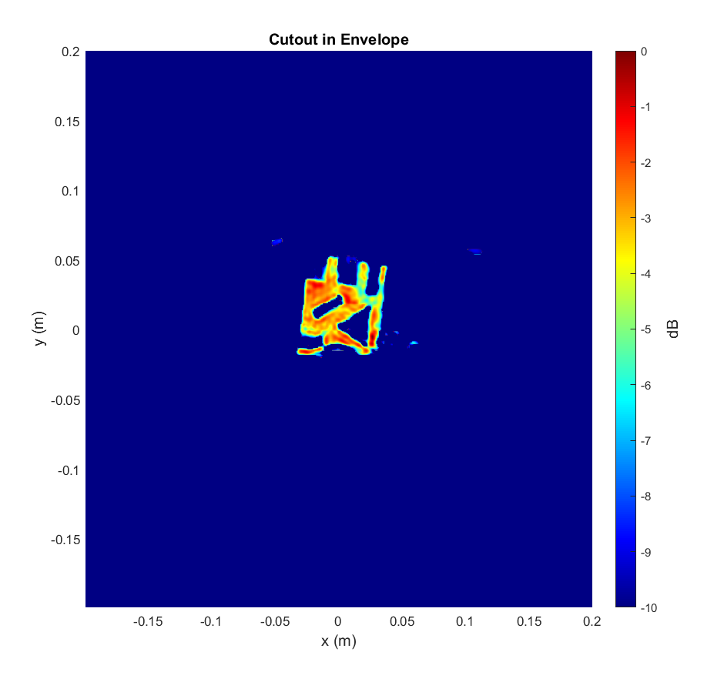
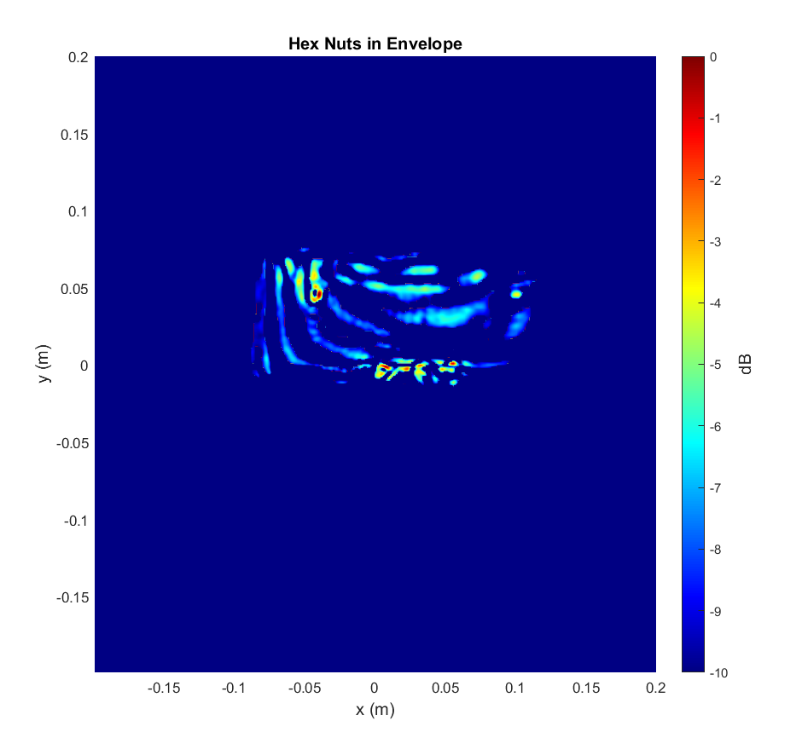
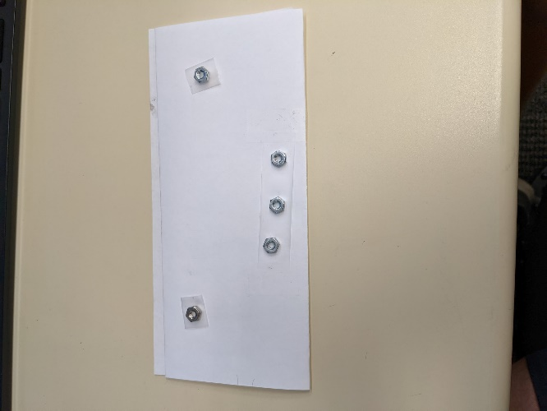
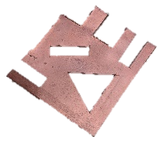
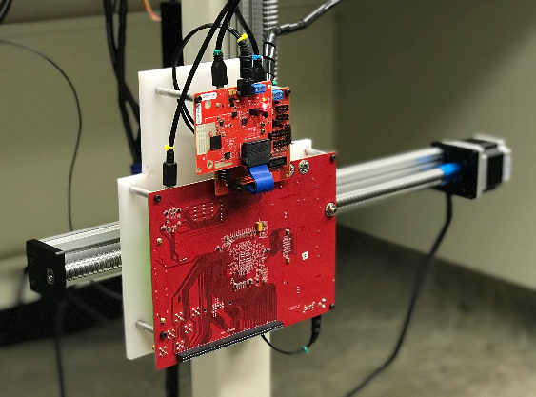
Early Results + Analysis
High Reflectivity Target
Strong reflection
Easily identifiable
Low Reflectivity Target
Weak reflection
Somewhat obscured by interferers
TI 77GHz mmWave Radar
Resolution scales with carrier frequency

Slide 15
Early Results + Analysis
Higher resolution can improve detection performance and image quality

Slide 16
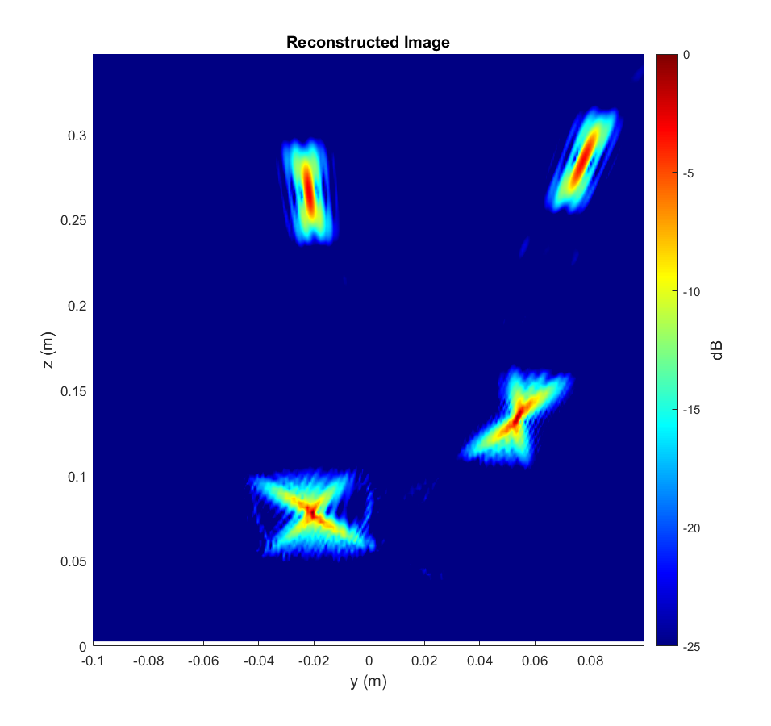
SAR Resolution - Motivation
Motivation for higher resolution
SAR images are blurry and distorted
Limited bandwidth, aperture effects, etc.
Can we improve the resolution of the recovered image? (“Denoising”)

Slide 17
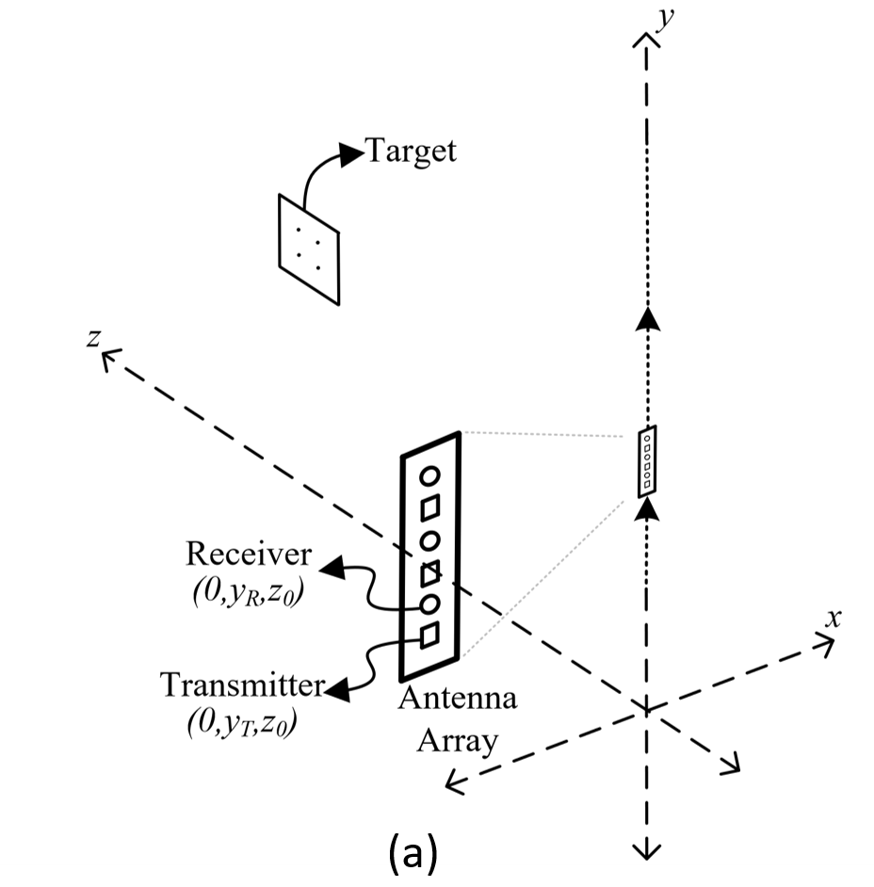
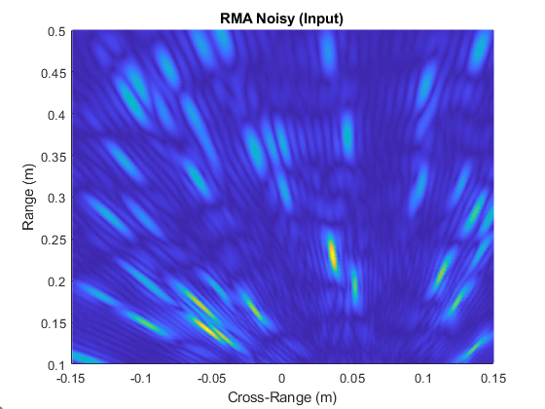
2D SAR Imaging
2D Imaging SAR Scanning
Linear scanning pattern
2D target
Recover image using range migration algorithm
Near-field beamformer
Resulting raw image is blurry and distorted
Raw RMA Image

Slide 18
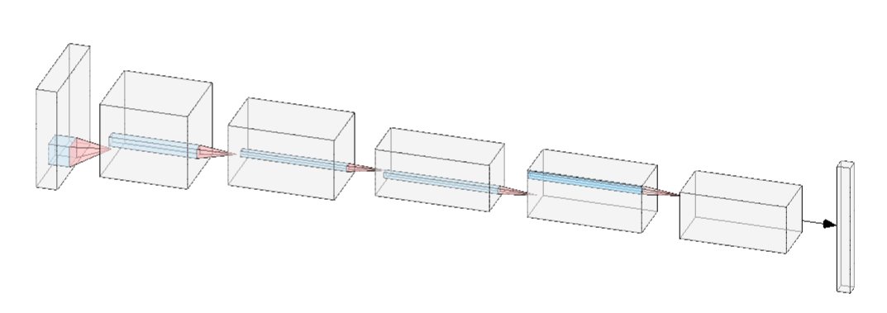
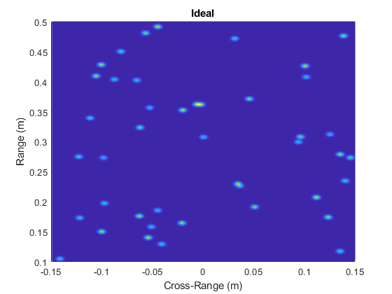
Proposed ML Solution
Convolutional Neural Network
Learns spatial features
Highly effective on structured images
Supervised learning
Synthetically generated features and labels (randomly placed points)
Training Features:
Image of randomly placed point targets recovered using RMA
Training Labels:
Corresponding ideal image. Each point target treated as narrow 2-D Gaussian pulse

Slide 19
Proposed ML Solution
The network will learn to remove the distortion from each RMA image to its corresponding ideal image
CNN learns and removes distortions (improves resolution)
Limited aperture effects, spherical wave approximation, limited bandwidth, path loss, etc.
Features: Raw Distorted Images
Labels: High Resolution Images
Image Enhancement CNN

Slide 20
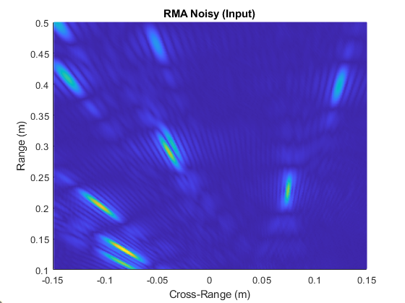
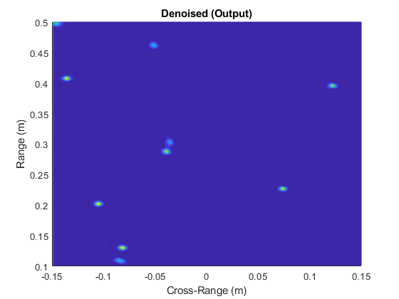
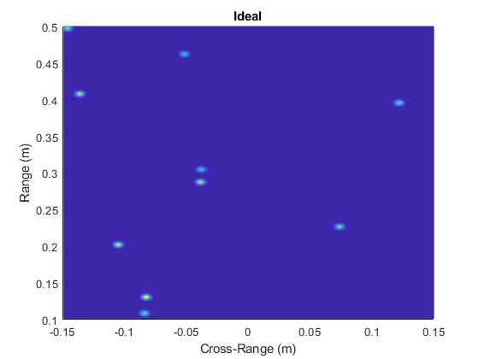
Results – Random Points
The algorithm has never seen this target before

Slide 21
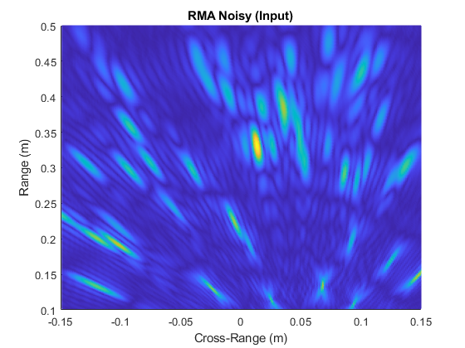
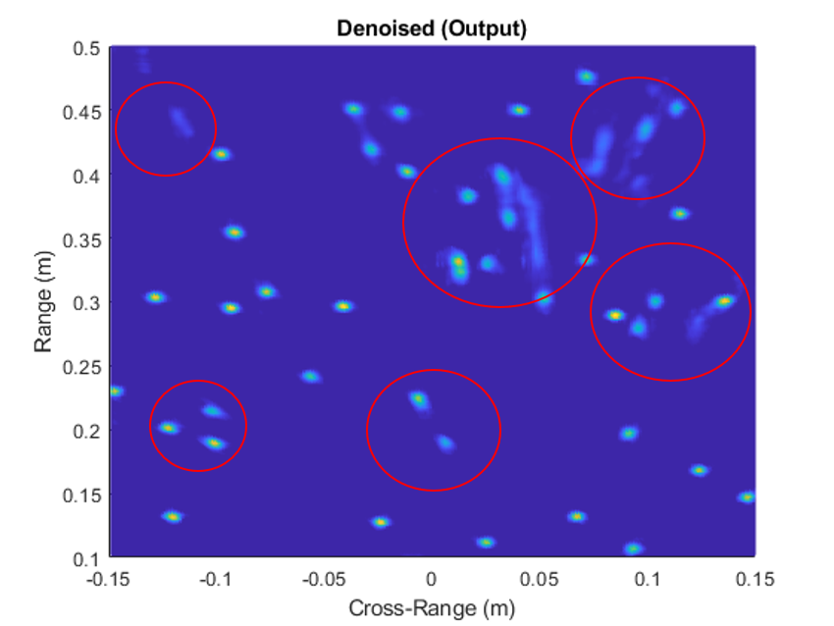
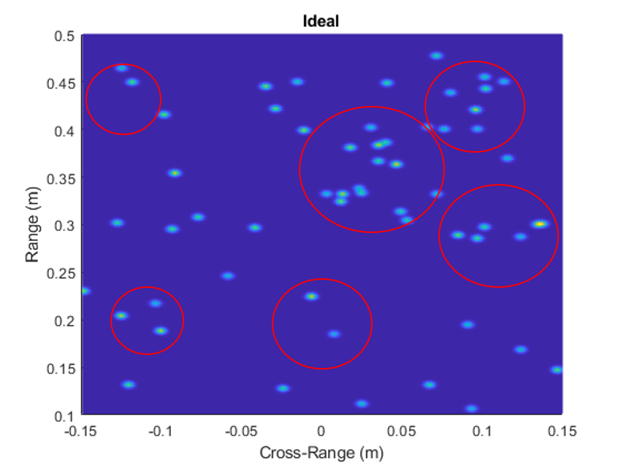
Results – Random Points
The algorithm has never seen this target before

Slide 22
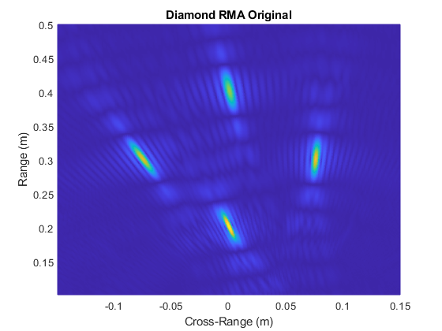
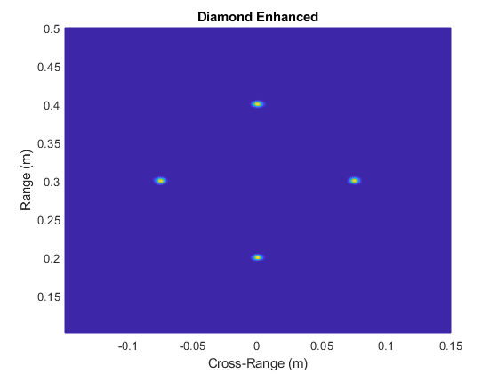
Results – Diamond
The algorithm has never seen this target before

Slide 23
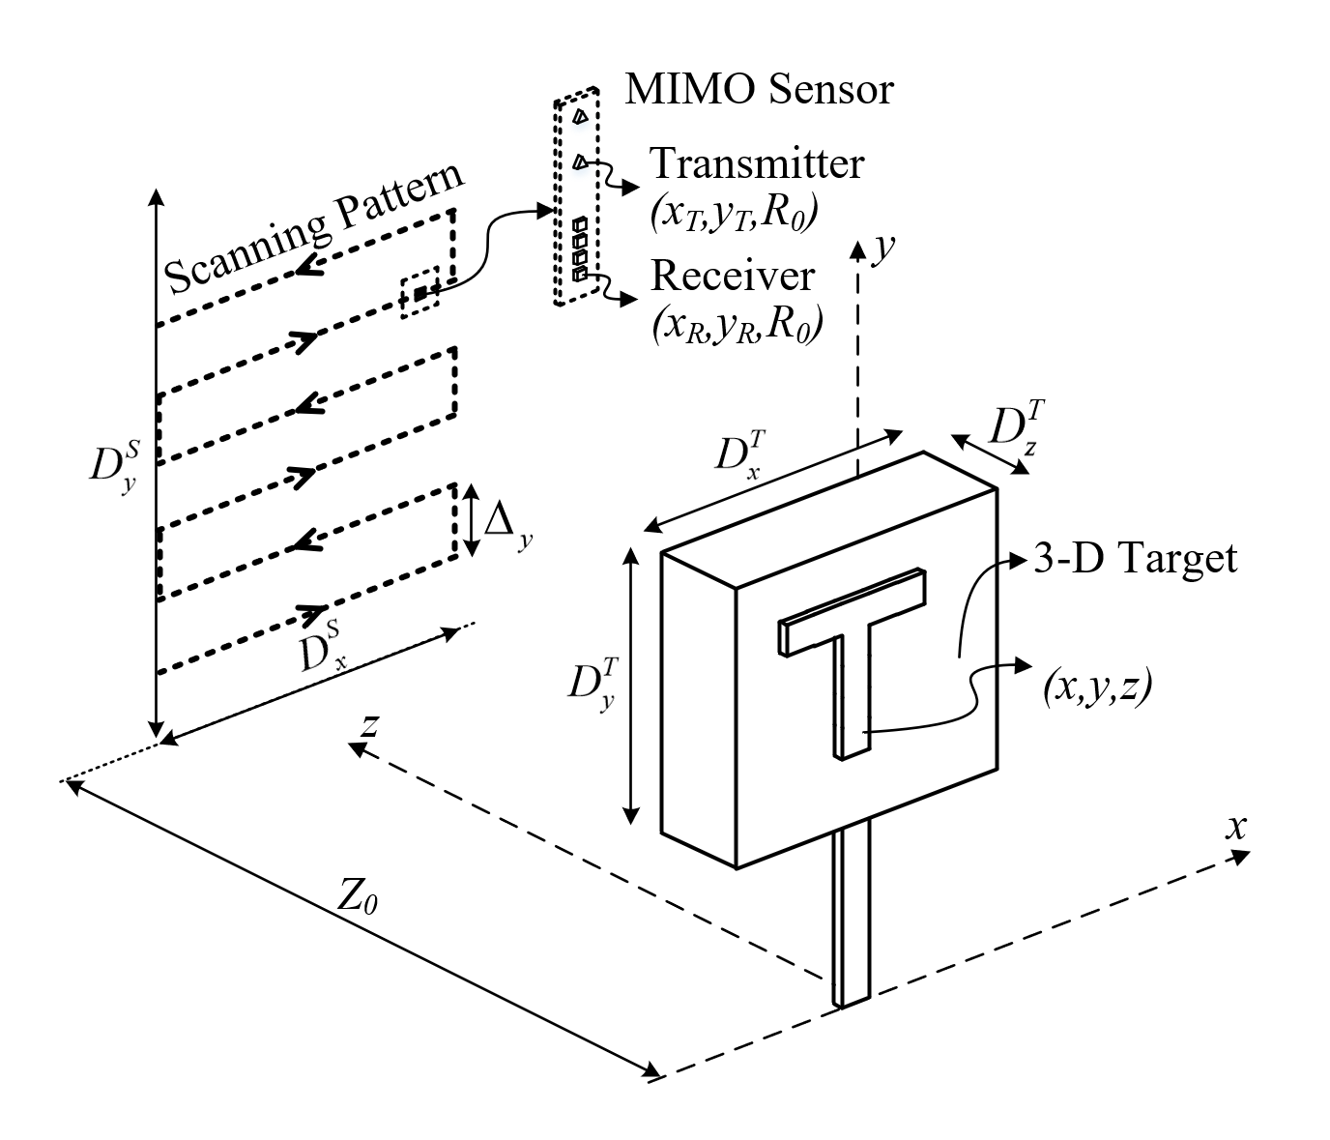
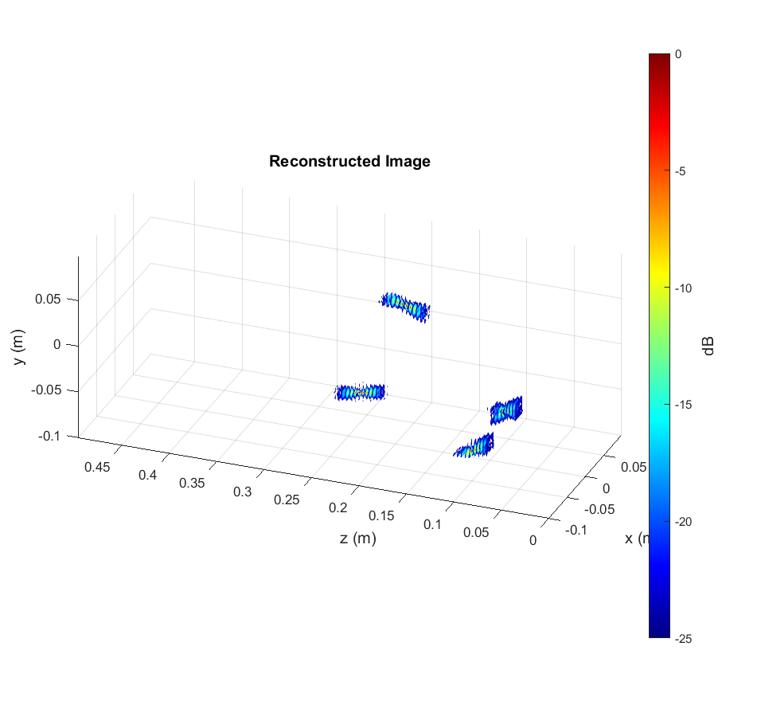
3D SAR Imaging
3D Imaging SAR Scanning
Rectangular scanning pattern
3D target
Random points + solid objects

Slide 24
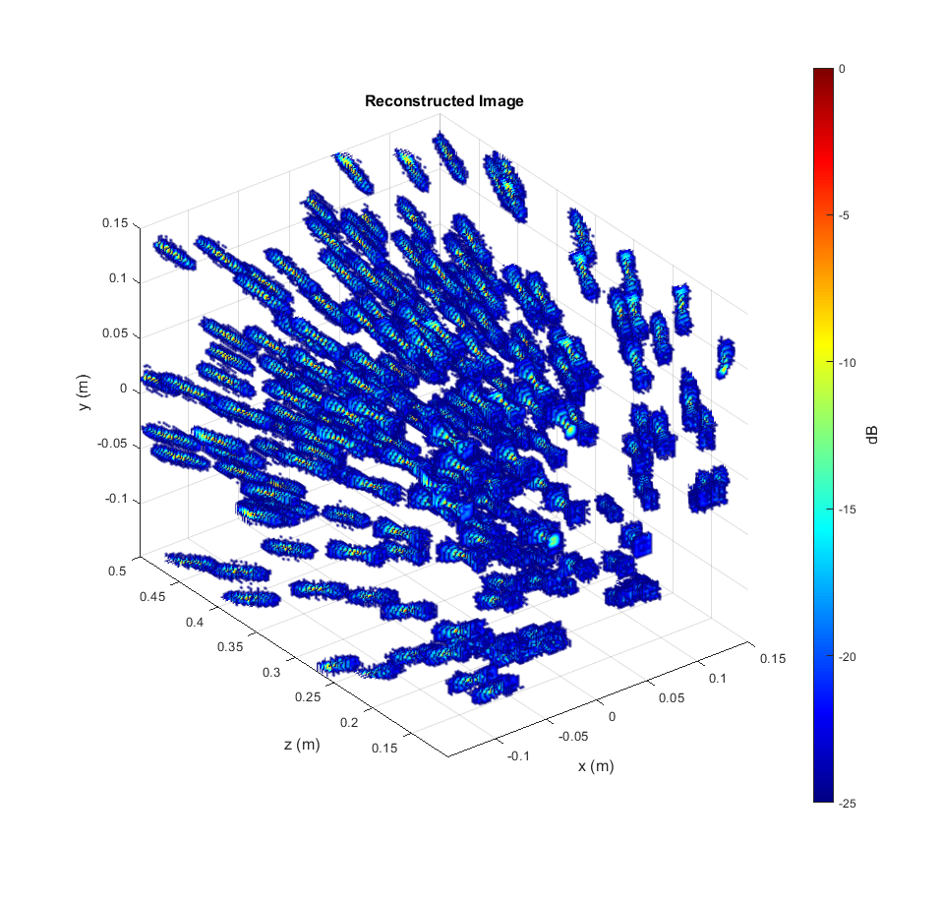
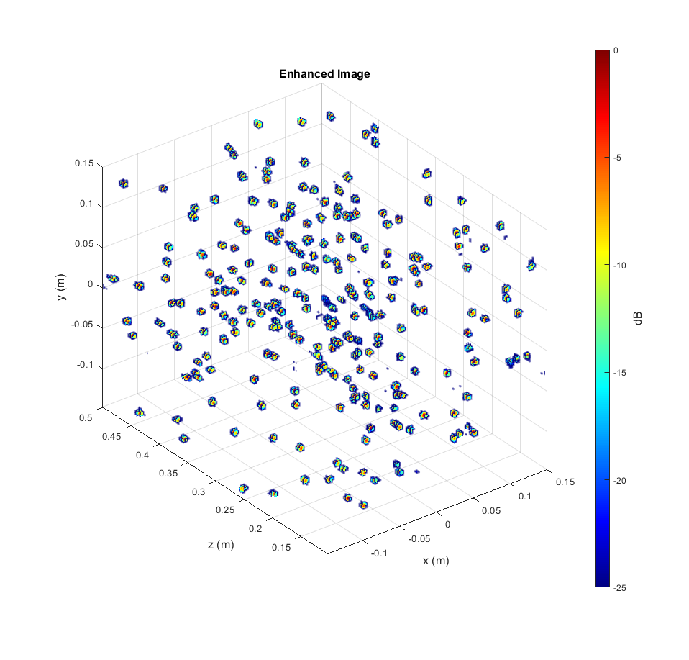
Results – Random Points
The algorithm has never seen this target before

Slide 25
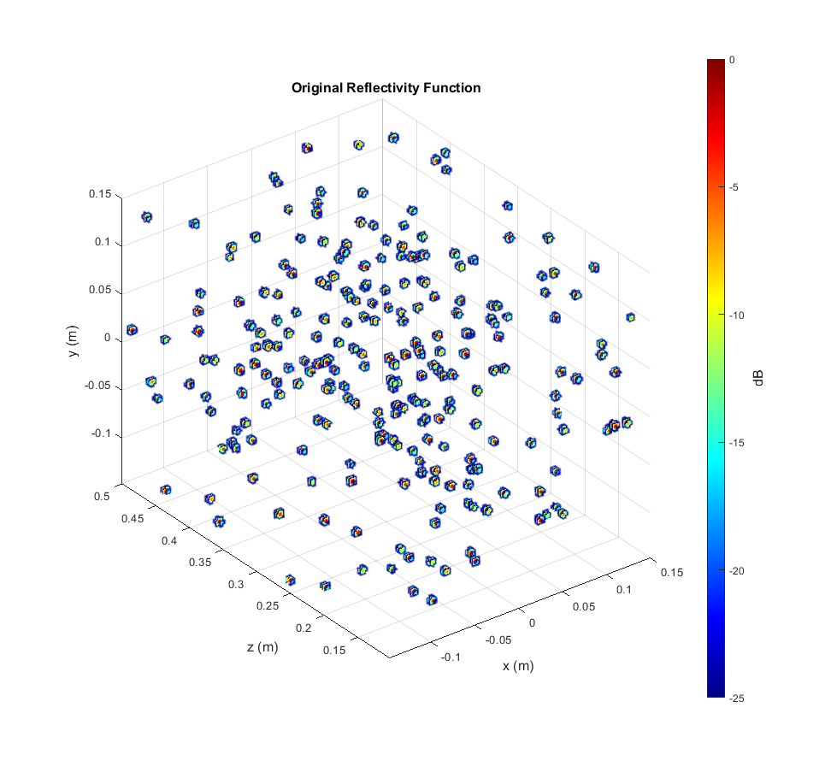
Results – Random Points
The algorithm has never seen this target before

Slide 26
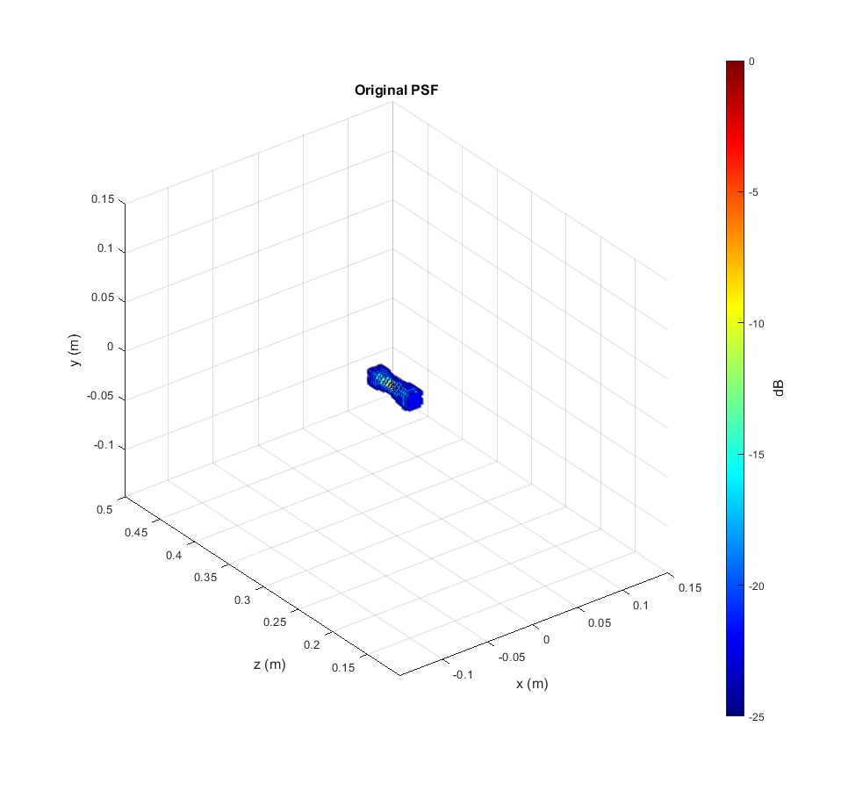
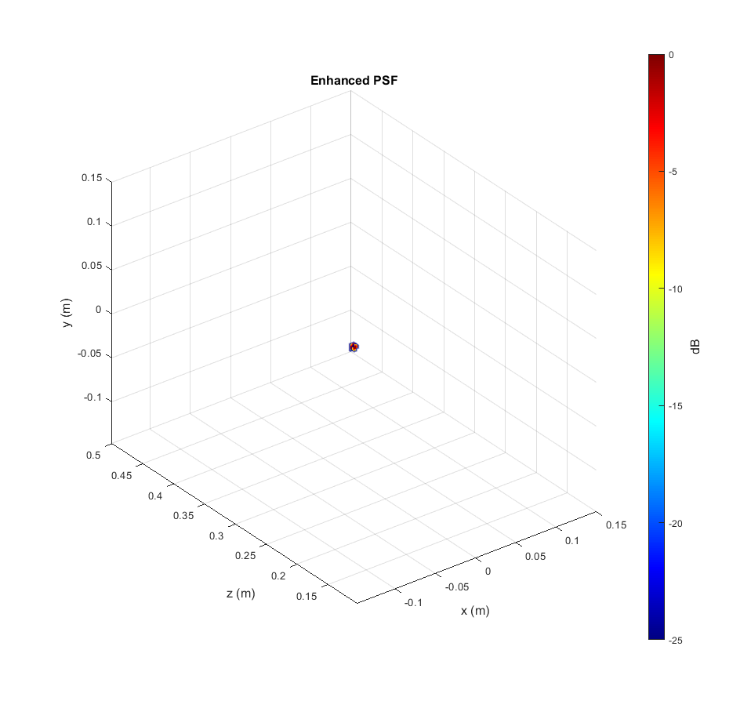
Results – PSF
The algorithm has never seen this target before

Slide 27
Results – PSF Comparison
The algorithm has never seen this target before

Slide 28
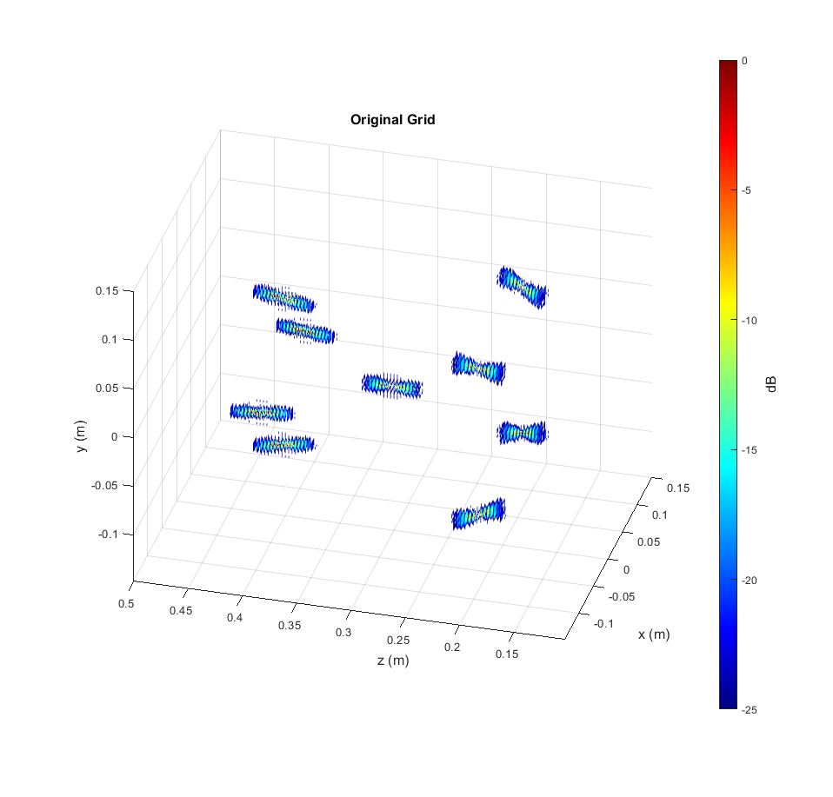
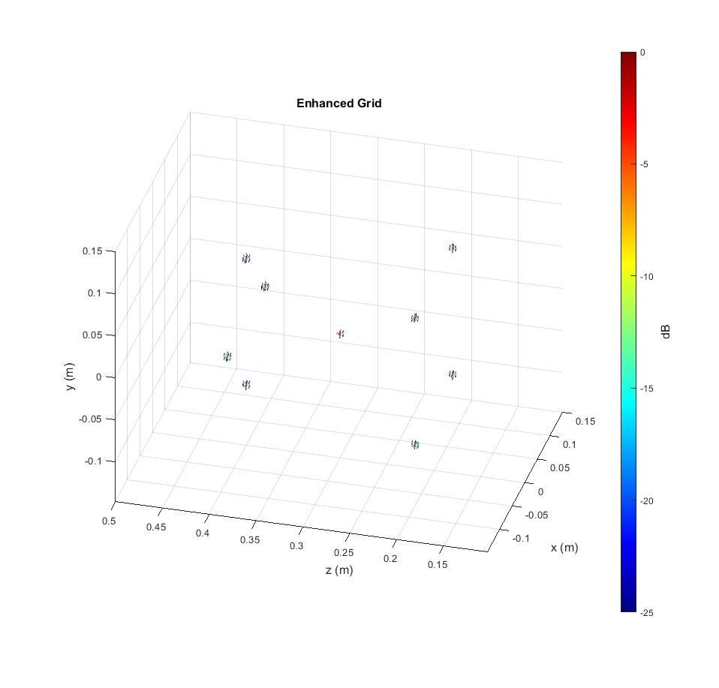
Results – Grid of Points
The algorithm has never seen this target before

Slide 29
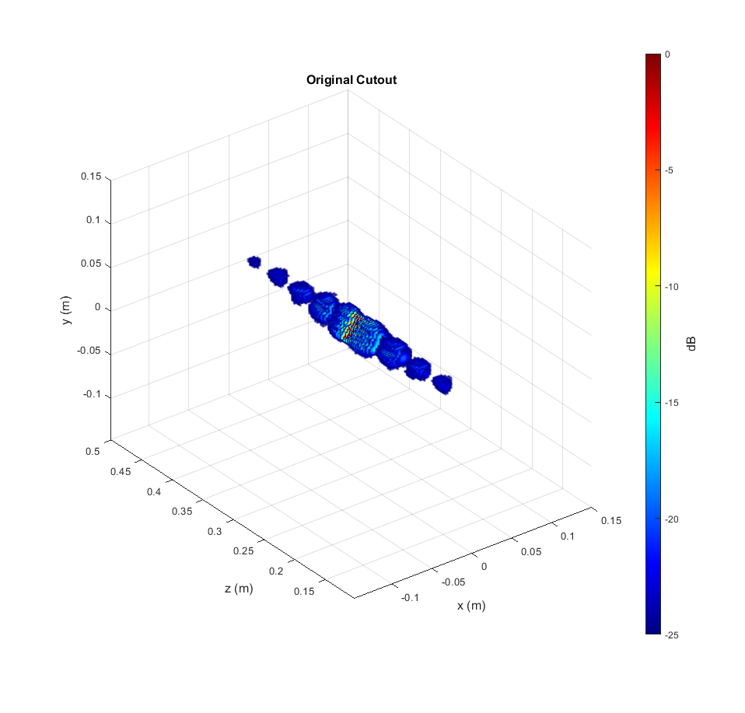
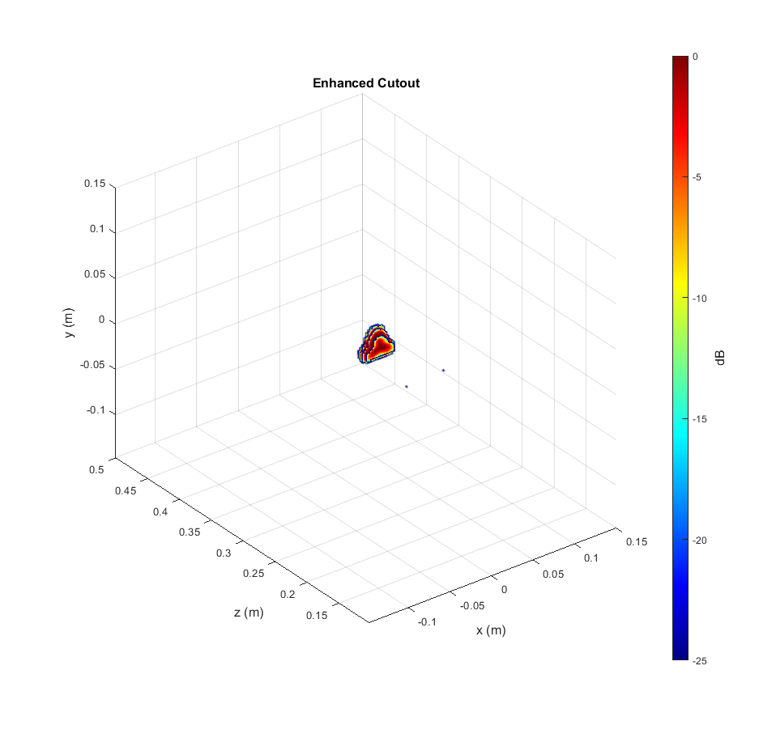
Results – Triangle
The algorithm has never seen this target before

Slide 30
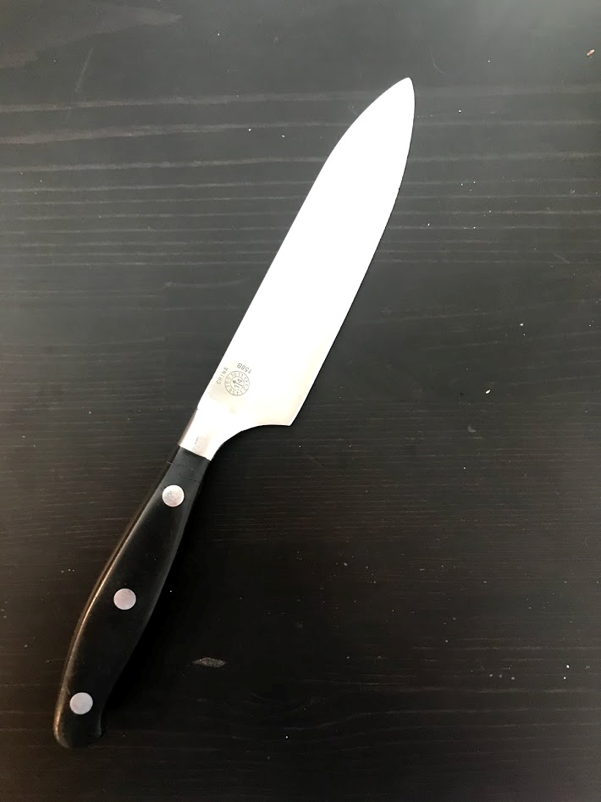
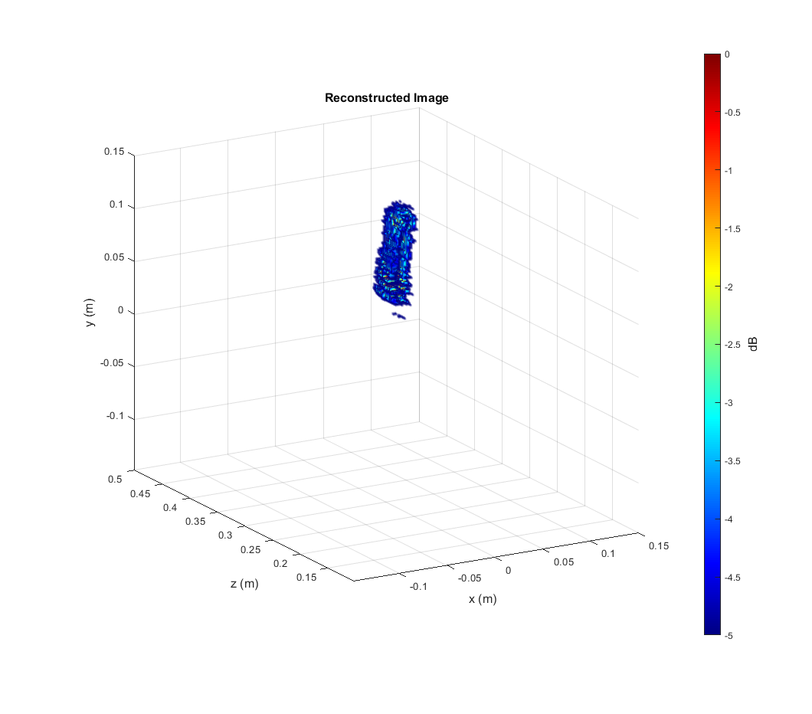
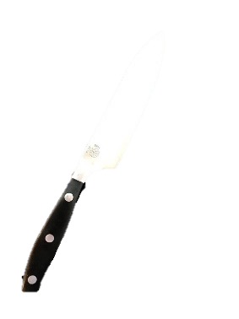
Empirical Results - Knife
Threshold at 5 dB
The algorithm has never seen this target before

Slide 31
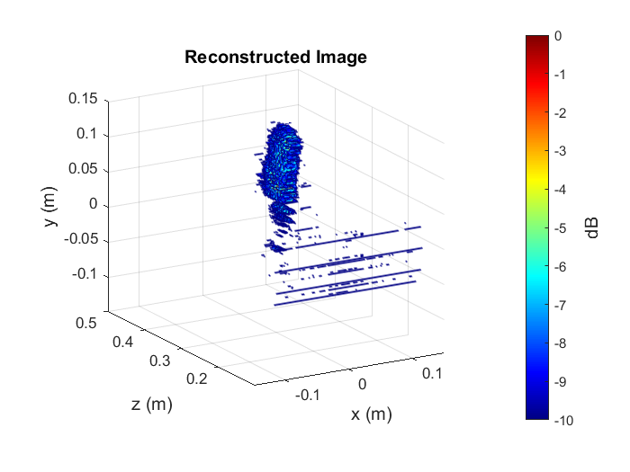
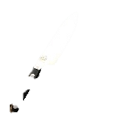

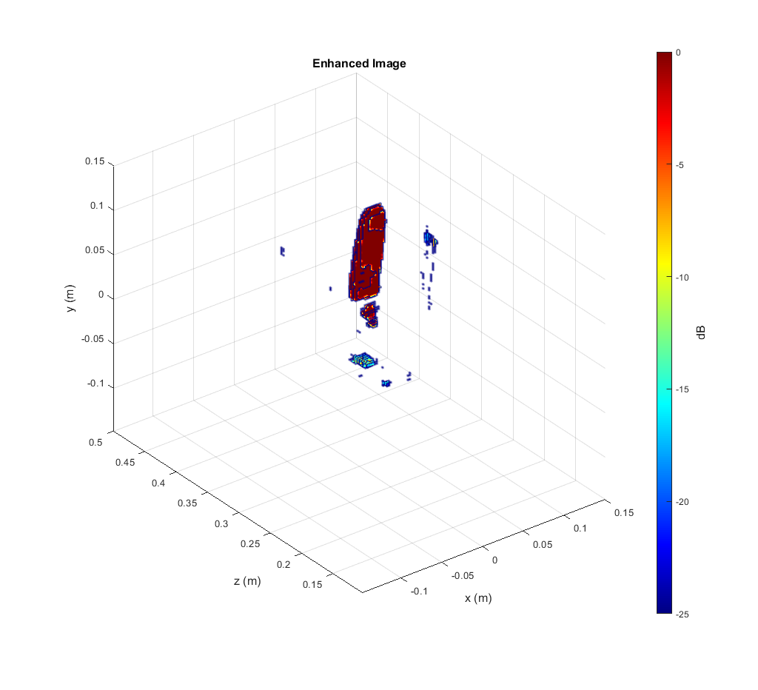
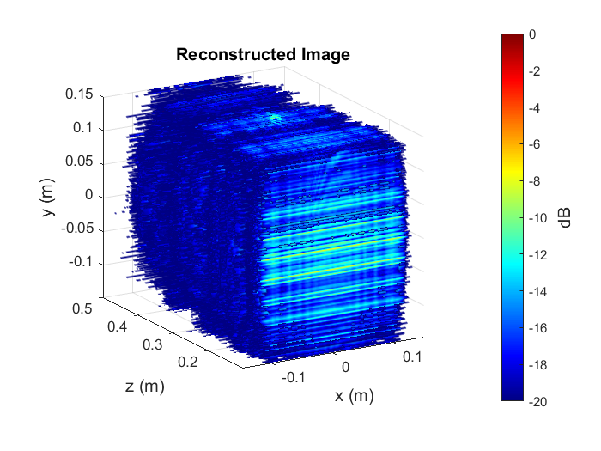
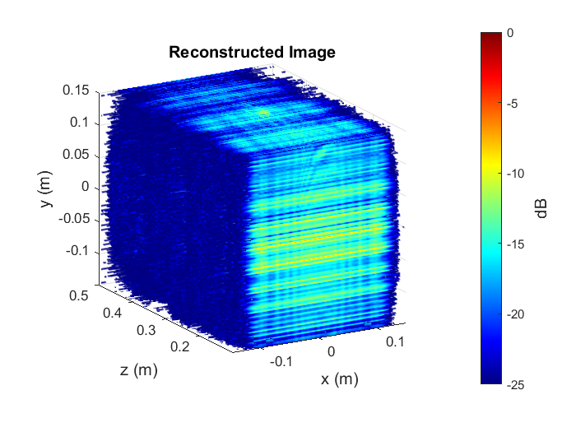

Empirical Results - Knife
5 dB
10 dB
Metal Dots in the handle are now shown (notice dynamic range 25dB)
- Considerable denoising is achieved
20 dB
25 dB
The algorithm has never seen this target before

Slide 32
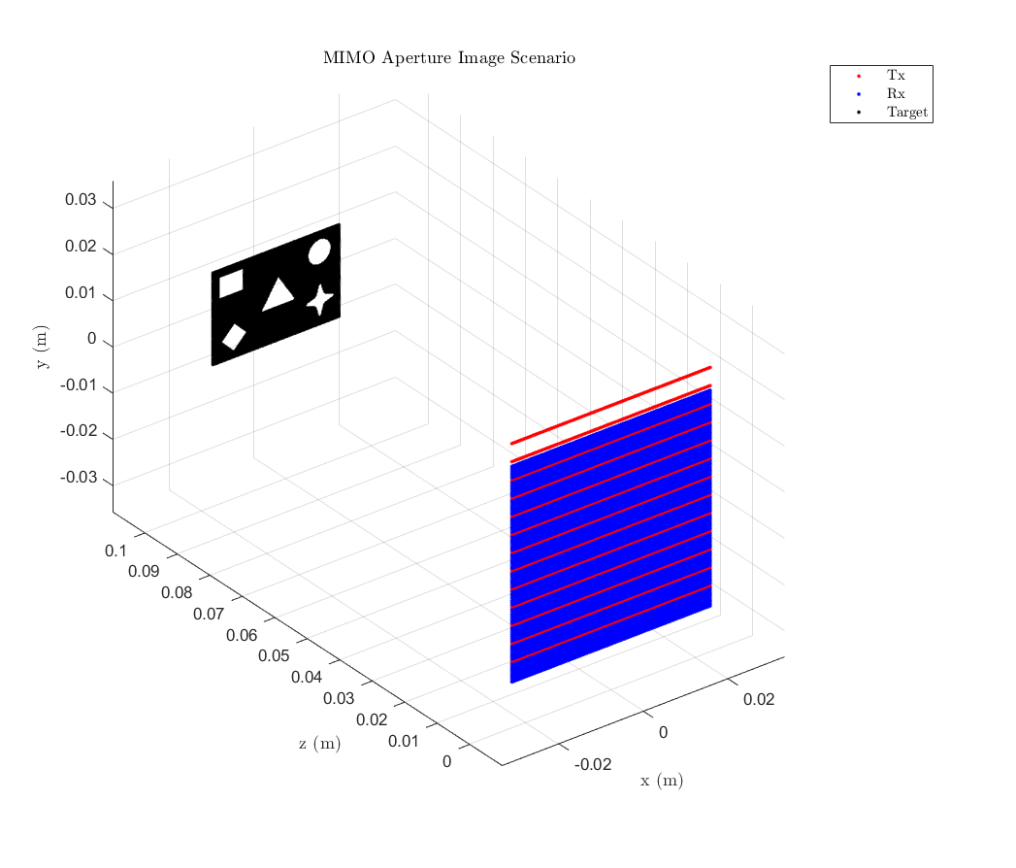
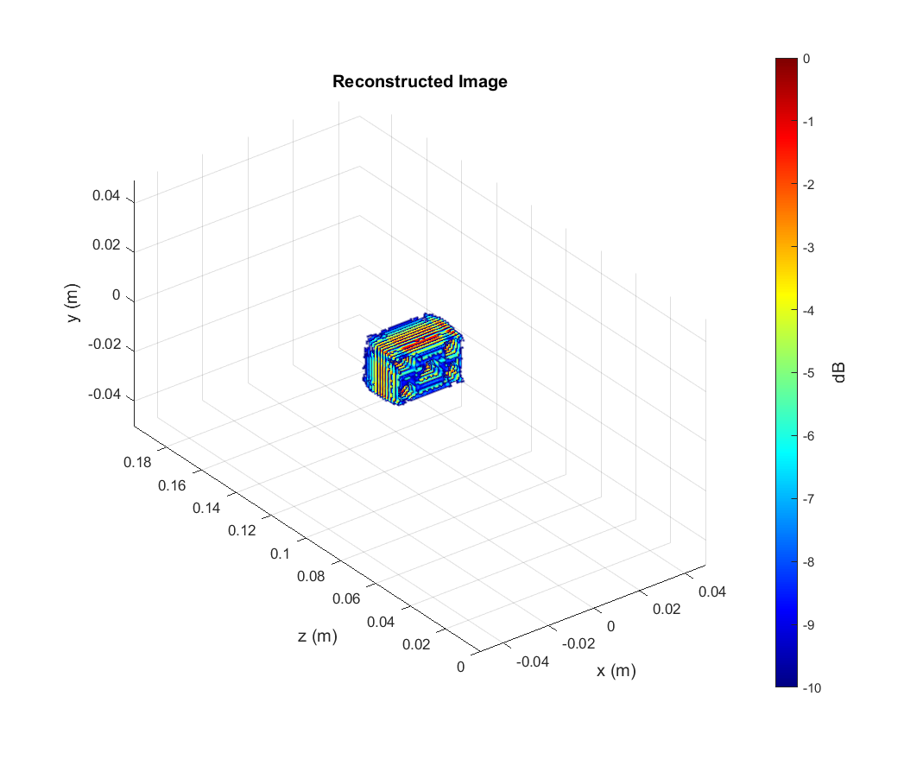
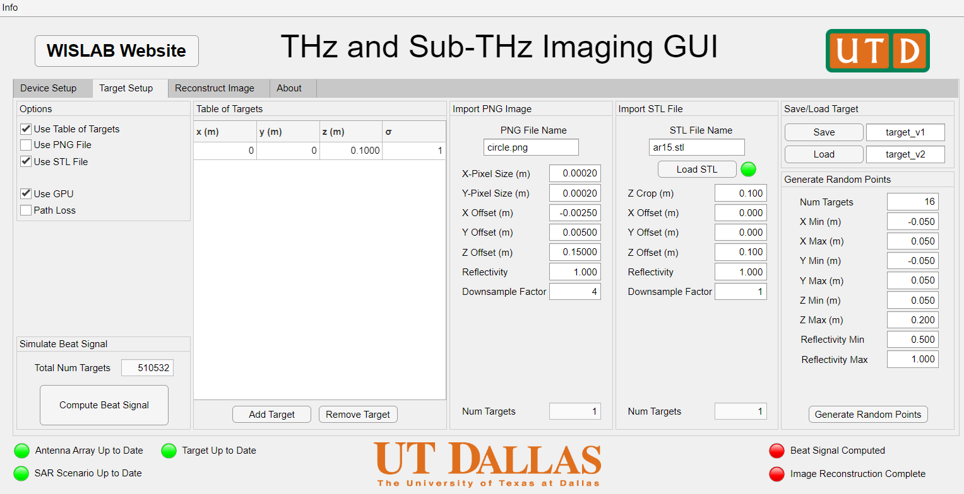
Data Generation – Synthetic Data
SAR image simulation pipeline
Interactive GUI
Efficient dataset generation
Flexible for any scanning mode
Journal paper on simulation pipeline in progress

Slide 33
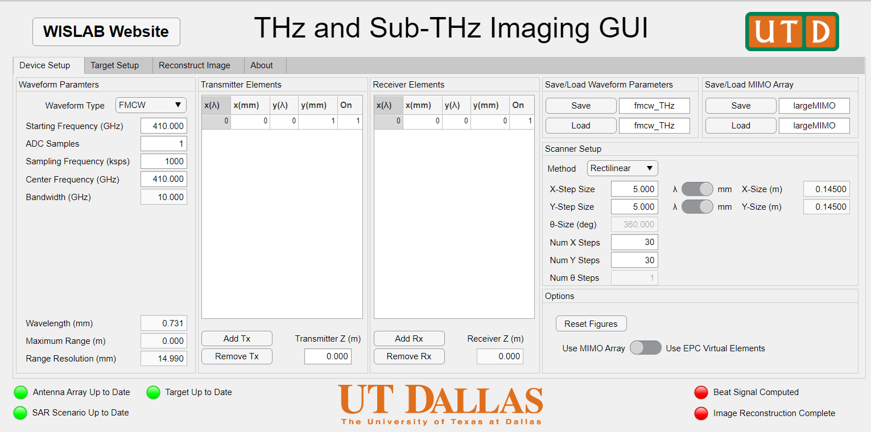
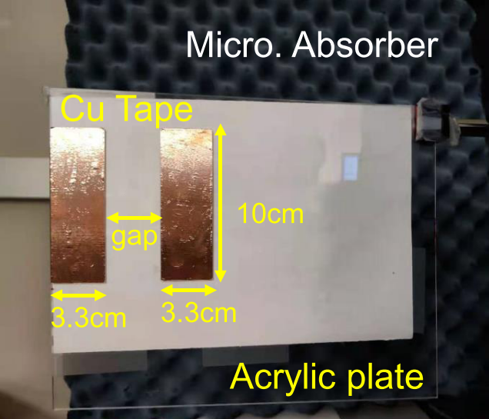
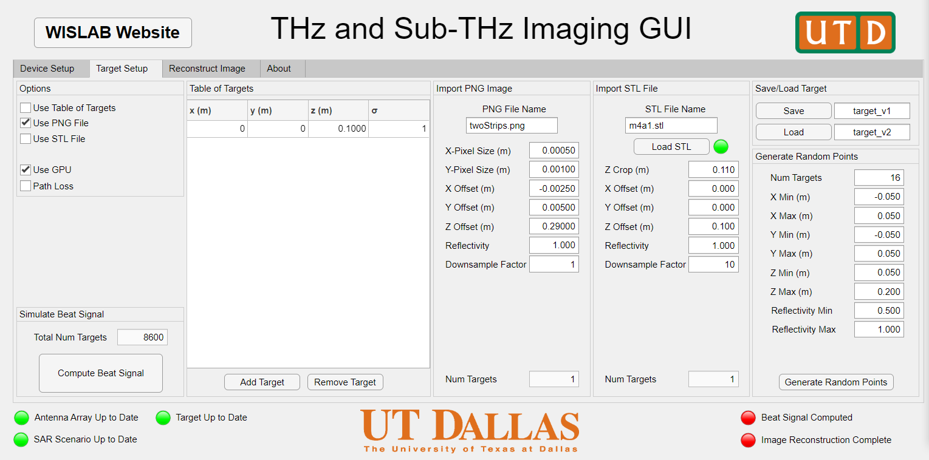

Data Generation – Simulation Software
Waveform + Array + Scan Setup
Target + Simulation Setup

Slide 34

Data Generation – Synthetic Data
Introduce array position error in simulation algorithm
Simulate scanner position ambiguity

Slide 35



Data Generation – Synthetic Data
Array position error
Some point targets are ill-resolved
Lost definition of shapes

Slide 36

CNN Results – With Position Error
The algorithm has never seen this target before

Slide 37






Data Generation – Real SAR Images

Slide 38

THz Imager Integration
Image credit: Dr. Wooyeol Choi
2500x averaging of a 60 sample window sampled at 150 MS/s

Slide 39



THz Imaging Examples
USRP Data vs Spectrum Analyzer

Slide 40



Motion Detection via Phase Extraction
50kHz
USRP
Software
273.6GHz
480MHz
250kHz
RF-TX
RF-RX
IF
D-IF
MD-IF
LPF
100kHz
479.75GHz
200kHz
Signal Generator
Signal Generator
Phase
Phase Extractor
Signal generators modulate carrier with pulse train
$$m_{TX}\left(t\right)=\sum_{i=1}^{N}{e^{j2πf_{TX}t}Π\left(\frac{t−nT_{P}}{W_{P}}\right)}$$
$$m_{RX}\left(t\right)=m_{TX}(t−τ)$$
$$=\sum_{i=1}^{N}{e^{j2πf_{TX}(t−τ)}Π\left(\frac{t−τ−nT_{P}}{W_{P}}\right)}$$

Slide 41

Relative Range Estimation
Moved radar 0.5mm radially from sensor
Uncalibrated
Observed phase difference:
$$φ=−2.554$$
Estimated range:
$$\hat{R}=0.4457mm$$
Calibrated
Observed phase difference:
$$φ=−2.8647$$
Estimated range:
$$\hat{R}=0.4999mm$$

Slide 42
Machine Learning Algorithms
Yiorgos Makris
Christos Vasileiou
Shiva S. Thiagarajan

Slide 43
Overview
Introduction
Dataset Description
CNN Architectures and Tuning
Denoising and Super Resolution Networks
U-Net Architecture
Results
Summary and Future Work

Slide 44
Introduction
Changing the radar application from gesture recognition to conveyor belt object recognition scenario
Collecting 2 types of data:
Simulated SAR data
Real SAR data
Simulated data – collected from MATLAB simulator with ideal images modeled by user
Real data – physical platform under construction to emulate the conveyor belt scenario
Currently, algorithms developed with simulated data (to be augmented with real data in the future)

Slide 45


Denoising: Randomized Points Dataset
Randomized points:
1024 pairs
75% train, 12.5% validation, 12.5% test
Input: SAR, Target: Ideal
Rescaled data to have a mean of 0 and a variance of 1
Ground truth
Simulated Data

Slide 46


Denoising: Solid Object Dataset
Solid SAR objects along with Randomized points:
Scanned on x-y axis
2048 pairs
75% train, 12.5% validation, 12.5% test
Rescaled data to have a mean of 0 and a variance of 1
Ground truth
Simulated Data

Slide 47


CNN Architectures
Architecture 1
Experiment to determine the effects of final CNN layer in image denoising
Model 1: Only convolutional final layer
Model 2: Convolutional + Batch normalization layer
Model 3 : Convolutional + BN + Activation Function
Training: 5 trials, 150 epochs
Approximately 21 hours on TXACE server
Parameters tuned by Ax-platform
learning rate
weight decay
scheduler’s parameters
Architecture 2/3
# Arch | Loss Magnitude | Valid | Test
 | Train | Valid | Test
1 | 26.3M | 26.5M | 26.1M
2 | 15.8M | 16.3M | 15.9M
3 | 56.4M | 56.9M | 56.5M

Slide 48

Automating CNN Architectures
Input
Modified Ax platform to include tuning of:
kernel size, padding, output channels, learning hyperparameters
Modifications to Ax-platform to maintain the image resolution in the intermediate layers
10 trials of 150 epochs each
Observations:
Many architectures with deeper pipelines cause overfitting
N
Output
Dataset | Loss Magnitude |  |  | N Layers | K0 | Ch0 | K1 | Ch1 | K2 | Ch2 | K3 | Ch3
 | Train | Valid | Test
Rand | 11M | 11M | 11M | 3 | 1 | 39 | 5 | 16 | 19 | 1 | - | -
Solid | 1M | 1M | 1.1M | 3 | 21 | 17 | 9 | 21 | 17 | 1 | - | -
Showing results for best trial out of all

Slide 49



Results: Randomized Points Dataset
Visual inspection of output with the best performance
Ground truth
Simulated Data
Predicted Output

Slide 50



Results: Solid Object Dataset
Visual inspection of output with the best performance
Ground truth
Simulated Data
Predicted Output

Slide 51


Super-Resolution Techniques
U-Net:
A pair of Encoder-Decoder
Encoder: down-sampling
Decoder: up-sampling
Architecture:
Bottleneck called the structure of 2 subsequent conv operation.
4 levels of down-sampling/up-sampling
Encoder:
Doubling feature channels to propagate more features to higher resolution layers
Decoder
Reduces feature channels to concatenate feature information
Extrapolates border pixels
Ratio resolution reduction:
R = $\frac{572−388}{572}$ = 32.1%, approx.
Encoder
Decoder
1. Karim Armanious, Sherif Abdulatif , Fady Aziz, Urs Schneider and Bin Yang, “An Adversarial Super-Resolution Remedy for Radar Design Trade-offs”, University of Stuttgart, Germany
2. O. Ronneberger, P. Fischer, and T. Brox, “U-net: Convolutional networks for biomedical image segmentation,” in International Conference on Medical image computing and computer-assisted intervention. Springer, 2015, pp. 234–241.

Slide 52

U-Net Adaptation (2-level architecture)
input
output
U-Net:
ratio resolution reduction:
R = 15.6%
2 levels of down-sampling and up-sampling
No use of any normalization layer
Architecture depth=2, output resolution=216

Slide 53

U-Net Adaptation (3-level architecture)
input
output
U-Net:
ratio resolution reduction:
R = 35.9%
3 levels of down-sampling and up-sampling
No use of any normalization layer
Architecture depth=3, output resolution=164

Slide 54
Results: U-Net Adaptation
# | Train Loss | Valid Loss | Test Loss | Depth | Chan
0 | 6,043,501 | 6,173,947 | 5,843,181 | 2 | 5
1 | 4,590,506 | 4,786,857 | 4,398,856 | 3 | 5
2 | 4,223,026 | 4,363,481 | 4,205,381 | 3 | 4
3 | 10,251,407 | 10,782,262 | 9,780,521 | 2 | 4
4 | 10,211,825 | 10,740,055 | 9,741,033 | 2 | 4
5 | 3,925,532 | 4,018,173 | 3,889,525 | 3 | 5
6 | 3,946,824 | 4,052,776 | 3,926,323 | 3 | 5
7 | 3,893,875 | 4,021,239 | 3,892,503 | 3 | 5
8 | 3,868,090 | 3,972,214 | 3,810,663 | 3 | 5
9 | 3,946,370 | 4,050,102 | 3,920,385 | 3 | 5
U-Net:
Ax platform integration. Tunes:
lr, scheduler’s params, depth
Solid object dataset trained on TxACE servers
10 trials; 30 epochs
Output resolution: 216x216 or 164x164. Depending on the depth level
Input resolution of 256x256 changed to match target resolution
Resized using scipy library and zoom() method with spline order 1

Slide 55




Results: U-Net Adaptation
Visual inspection of output with the best performance
Ground truth
Modified Ground Truth
Simulated Data
Predicted Output

Slide 56

U-Net Adaptation with Data Modifications
# | Train Loss | Valid Loss | Test Loss | depth
0 | 5.4M | 5.46M | 5.75M | 2
1 | 6.8M | 6.99M | 7.37M | 3
2 | 14.08M | 14.74M | 15.5M | 3
3 | 14.06M | 14.73M | 15.49M | 2
4 | 14M | 14.68M | 15.43M | 2
5 | 3M | 2.92M | 3.04M | 2
6 | 2.94M | 2.84M | 2.95M | 2
7 | 7.65M | 7.47M | 7.78M | 2
8 | 3.67M | 3.43M | 3.71 | 2
9 | 3.33M | 3.11M | 3.26M | 2
input
output
Addition of normalization layer; 30 epoch training
Intermediate image resolution maintained across layers
ratio resolution reduction R = 0

Slide 57

Results
Visual inspection of output with the best performance
Simulated Data
Predicted Output

Slide 58

THz Application
Simulated solid object dataset - pixelated images of 256 x 256 (similar to THz images)
Denoising the images with regression techniques to reconstruct the original target
Classification models for gesture recognition using radar data was explored during Year 2/3
Frequency Response
Range (m)
No envelop
Simulated SAR image
Cardboard envelop
Envelop images adapted from Prof. Choi’s presentation

Slide 59
Summary / Future Work
Trained tunable CNN architectures for denoising radar images for the new conveyor belt application
Literature review to identify super-resolution techniques to improve the CNN architectures
Implemented U-Net architectures for improving the resolution of simulated SAR data
Plan to augment the model training with the new ‘real’ data using techniques such as transfer learning
Experiment with the U-Net architecture by automating the kernel selection process with Ax-platform
Explore unsupervised learning algorithms which can improve denoising by identifying radar noise distribution

Slide 60
Plans and Deliverables (Year 4)
Milestones
Continued to advance work on hand tracking with mmWave radars: reducing the tracking errors and revising an IEEE paper submission on sterile gesture recognition.
Cross-range resolution improvement from 15cm to 8mm using deep learning techniques
Modeling THz sensor phenomenon
Implemented feature extraction methods using ResNet to improve classification accuracy and working towards developing confidence estimation metrics to quantify overfitting.
Development of infrastructure to support real-time gesture recognitions by using OpenCV packages to interface radar sensors (hardware) and software
Deliverables (Revised)
Full THz imaging demo (May 31, 2022)
THz imaging testbed – Phase 1 (Dec 31, 2021)
IR testbed – Phase 1 (Dec 31, 2021)
Report on implementation of machine learning algorithms with THz images (Dec 31, 2021)
Establish final ML architecture pipeline to be implemented on THz demo platform (May 31, 2022)

